Slide 1

CSc 102 - Project
Zelalem S. Shibeshi
Together we can change the world

Slide 2
Main aspects of a GUI App
A Graphical User Interface (GUI) application uses visual elements such as buttons, menus, and windows to help users interact with it. The main aspects include:
User Interface Design (elements and layout):
Visual elements (e.g. buttons, text fields, checkboxes)
Window Management
Event Handling
Input Validation
Navigation and Flow
User interface" (UI) has evolved into the broader concept of "user experience” (UX) (which encompasses the overall experience a user has when interacting with a product or service and considers aspects like usability, accessibility, performance, aesthetics, and emotional impact.)
Notes:
UX design aims to create products that provide meaningful and relevant experiences to users, ensuring that the entire journey—from discovering the product to using it—is smooth, efficient, and enjoyable. It takes into account a user's entire interaction with the product, including how easy it is to navigate, how quickly they can achieve their goals, and how satisfied they feel after using it.

Slide 3
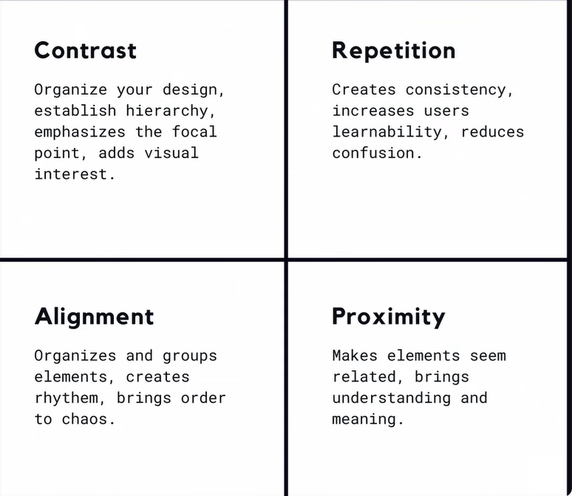
Important Design Principles

Slide 4
Event Programming
Involves designing and handling events that occur during the execution of a program, typically triggered by user interactions or other external factors, and includes:
Event Sources
Event Listeners (Handlers) (piece of code to handle e)
Event Types (e.g button click, mouse movement, etc)
Event Registration (register listeners to sources)
Event Handling Logic (to respond to an event)
Callback Mechanism (call back function)
Asynchronous Nature (can occur at any time)

Slide 5
Event Programming
Listeners - monitor and detect when an event occurs (through a process called event registration)
button.addMouseListener(new MouseListener() {
public void mouseClicked(MouseEvent e) {
// Code to execute when the mouse is clicked
}
});
Handlers - execute code in response to an event
public void mouseClicked(MouseEvent e) {
System.out.println("Mouse clicked!");
}

